Slide 1

Learning Objective
I will identify features of quadratic graphs.
Enter quietly, please be ready with the following on your desk:
Whiteboard
Whiteboard marker
Exercise Book
Pencil, pen, ruler and red pen
Diary
Calculator
Device – charged or borrowed from Library before maths

Slide 2
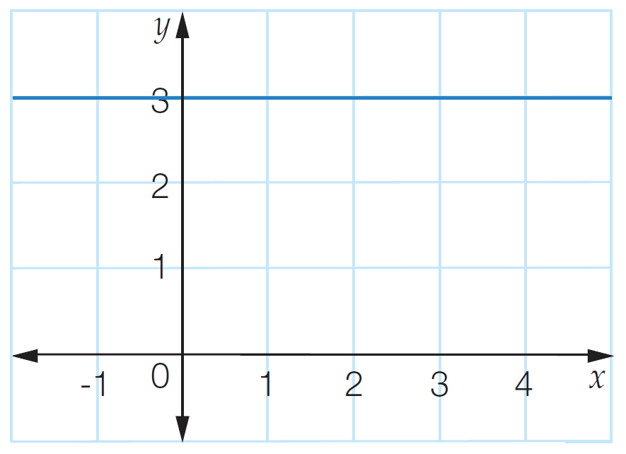
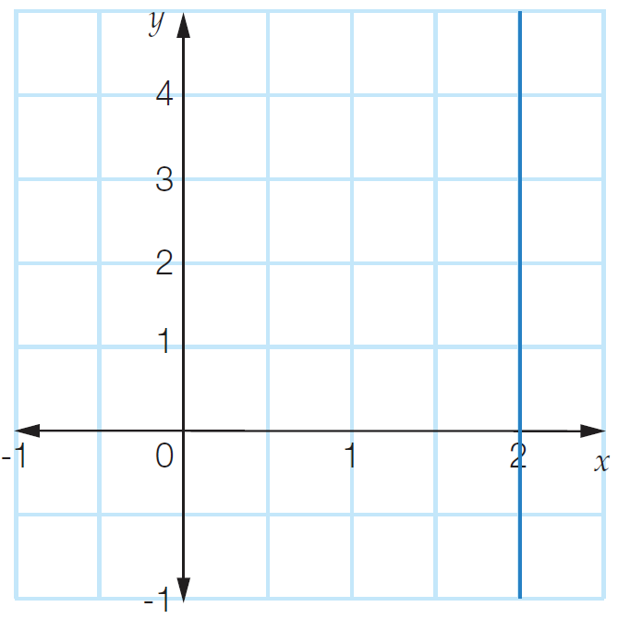
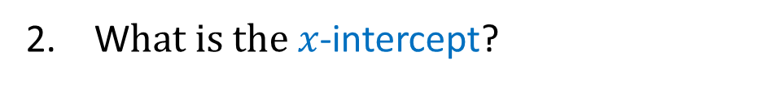



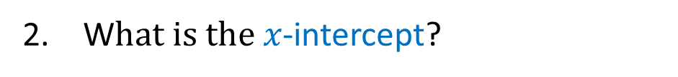

Activate Prior Knowledge
(0,3)
(2,0)
3
W$hat is the y$-intercept?
N/A
W$hat is the y$-intercept?
N/A
W$hat is the x$-intercept?
2
W$hat is the x$-intercept?
Write down 4 coordinates on this line.
Write down 4 coordinates on this line.
(1, 3) (2, 3) (4, 3) (-1, 3)
(2, 1) (2, 2) (2, 3) (2, -1)
The y value is 3.
4. What’s in common?
The x value is 2.
4. What’s in common?
5. What’s the equation of the line?
$$y = 3$$
$$x =2$$
5. What’s the equation of the line?

Slide 3




Daily Review
Sketch the graph of the following equation $y = x2+2x+3.$
We want to graph the equation $y = x2+2x+3$using integer
values of x from -3 to 2. Substitute each number into the equation to find the
points we need. (Use a scientific calculator and brackets to help you do this.)
$$y = x2+2x+3$$
$$y =\left(−3\right)2+2\left(−3\right)+3$$
$=+9−6+3$
$=6$
$$y = x2+2x+3$$
$$y =\left(−1\right)2+2\left(−1\right)+3$$
$=+1−2+3$
$=2$
$$y = x2+2x+3$$
$$y =\left(2\right)2+2\left(2\right)+3$$
$=4+4+3$
$=11$
x | -3 | -2 | -1 | 0 | 1 | 2
y | 6 | 3 | 2 | 3 | 6 | 11

Slide 4
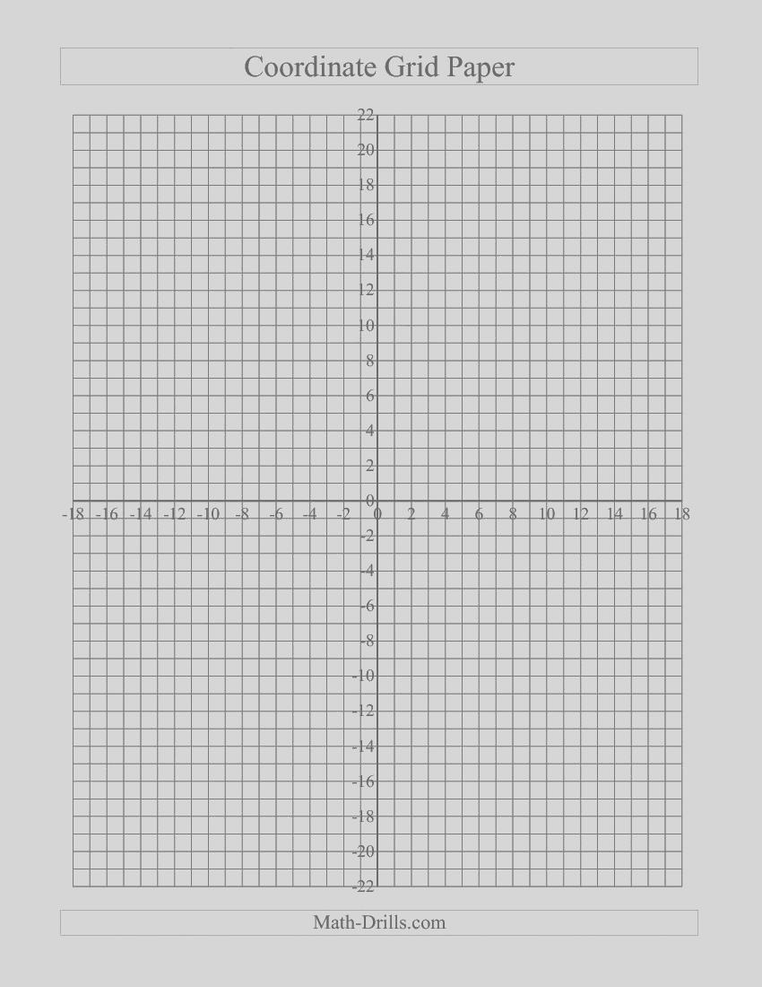
Daily Review
x-int (no x-intercept)
y-int (0,3)
x | -3 | -2 | -1 | 0 | 1 | 2
y | 6 | 3 | 2 | 3 | 6 | 11

Slide 5




Daily Review
Sketch the graph of the following equation $y =−2x2+1.$
We want to graph the equation $y =5x2+4$using integer
values of x from -3 to 2. Substitute each number into the equation to find the
points we need. (Use a scientific calculator and brackets to help you do this.)
$$y =−2x2+1$$
$$y =−2\left(−3\right)2+1$$
$=−2\left(9\right)+1$
$=−17$
$$y =−2x2+1$$
$$y =−2\left(−1\right)2+1$$
$=−2\left(1\right)+1$
$=−1$
$$y =−2x2+1$$
$$y =−2\left(2\right)2+1$$
$=−2(4)+1$
$=−7$
x | -3 | -2 | -1 | 0 | 1 | 2
y | -17 | -7 | -1 | 1 | -1 | -7

Slide 6
Daily Review
x | -3 | -2 | -1 | 0 | 1 | 2
y | -17 | -7 | -1 | 1 | -1 | -7
This quadratic relationship has a:
x-int (0.5,0) (-0.5, 0)
y-int (0,1)

Slide 7
Learning Objective
CFU 1
What will we learn?
I will identify features of quadratic graphs.
CFU 2
What will we learn?
CFU 3
How will we know if we’ve been successful?
Success Criteria
CFU 4
How will we know if we’ve been successful?
I will be able to:
Recognise if a parabola will have a minimum or maximum turning point.
Identify the x-intercepts of a parabola.
Identify the axis of symmetry of a parabola.

Slide 8
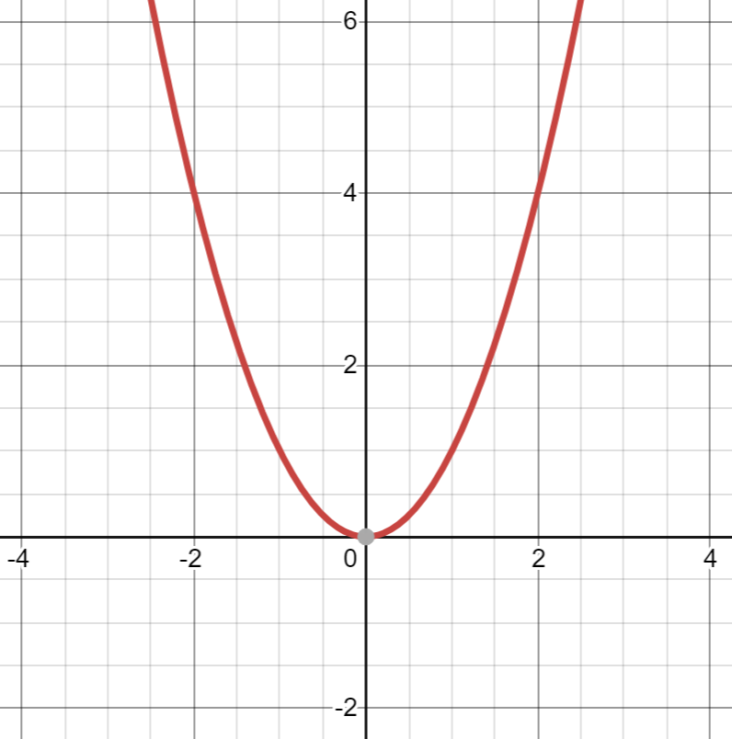
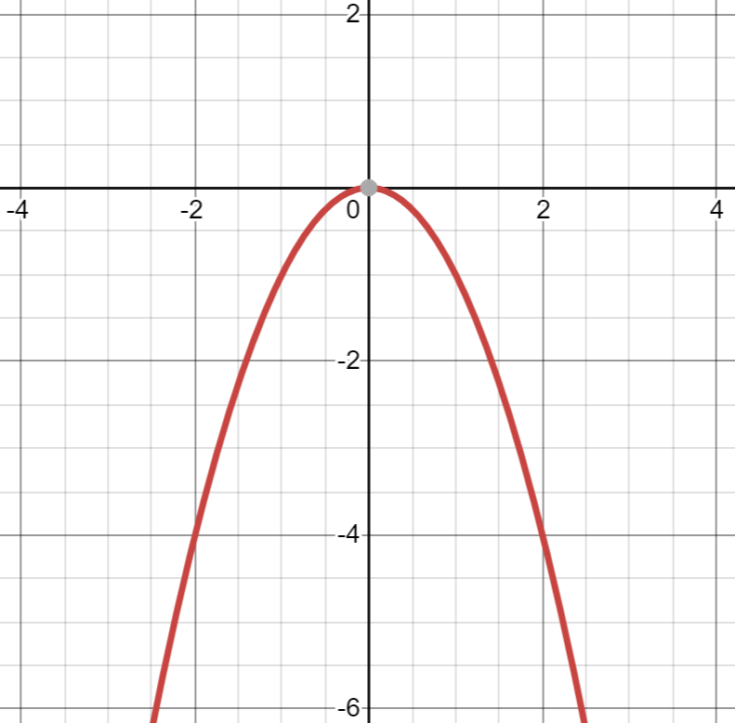

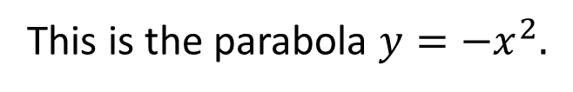

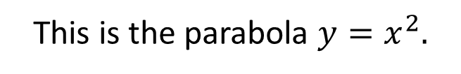
Activate Prior Knowledge
This is the parabola $y=x^{2}.$
This is the parabola $y={−x}^{2}.$
Its axis of symmetry is $x=0$.
Its axis of symmetry is $x=0$.
It has a minimum turning point at (0, 0).
It has a maximum turning point at (0, 0).
It has one x-intercept at 0.
It has one x-intercept at 0.

Slide 9
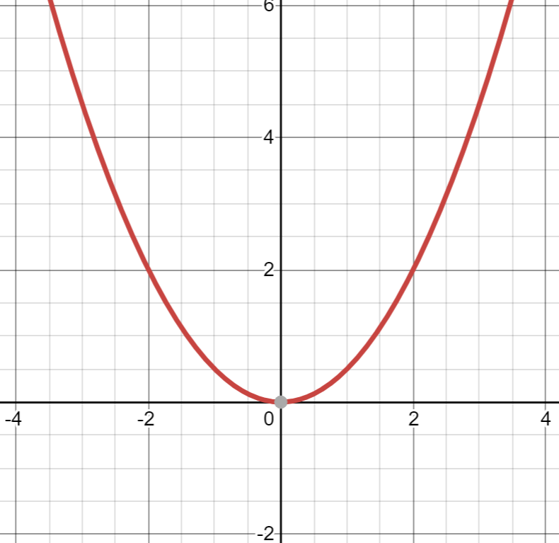
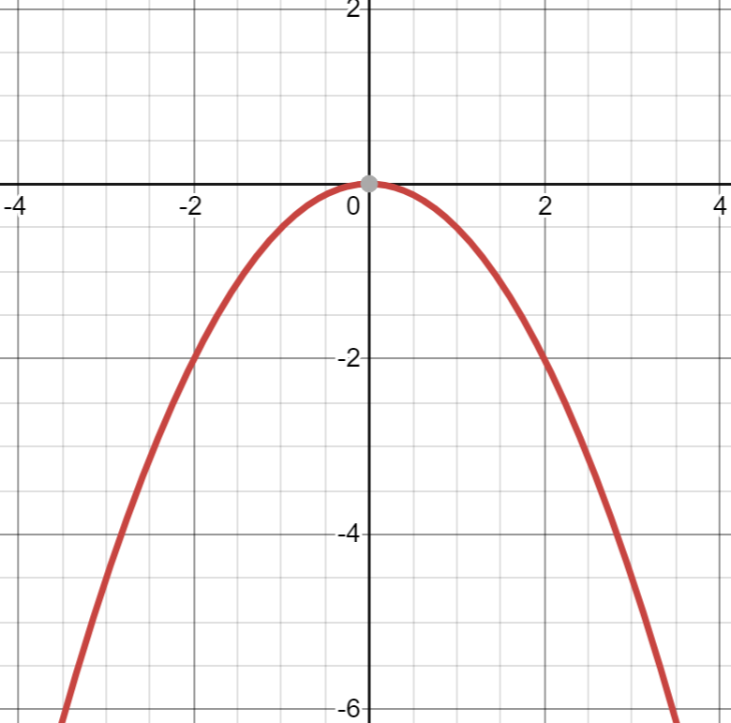

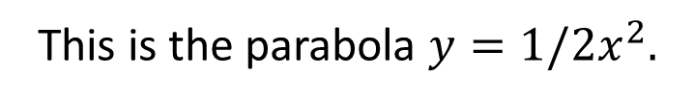
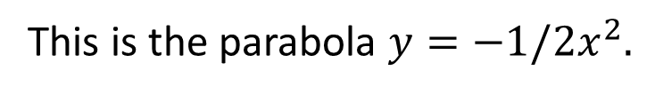

Concept Development
This is the parabola $y={1/2x}^{2}.$
This is the parabola $y={−1/2x}^{2}.$
If the coefficient of $x^{2}$is positive, the parabola will be a ‘u’ shape and will have a minimum turning point.
If the coefficient of $x^{2}$is negative, the parabola will be a ‘n’ shape and will have a maximum turning point.
Its axis of symmetry is $x=0$.
Its axis of symmetry is $x=0$.
It has a minimum turning point at (0, 0).
It has a maximum turning point at (0, 0).
It has one x-intercept at 0.
It has one x-intercept at 0.

Slide 10
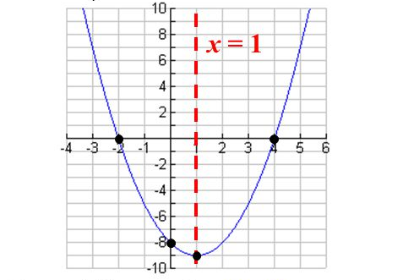
Concept Development
CFU 1
Does this parabola have a maximum or minimum turning point?
The graph of a quadratic equation is a parabola, as shown below.
Every parabola has:
A symmetrical shape about the line of symmetry
A turning point that is either a maximum turning point (n) or a minimum turning point (u)
Changing directions on either side of the turning point.
X-intercept (where it cuts x-axis):
- can have 2, 1 or 0 x-intercepts
CFU 2
How many x-intercepts does this parabola have?
CFU 3
What are the x-intercepts of this parabola?
VOCABULARY
Quadratic – an equation where the highest power is 2 Parabola – the graph of a quadratic equation (looks like a u or a n)

Slide 11

Concept Development
The graph of a quadratic equation is a parabola, as shown below.
Every parabola has:
An axis of symmetry
A maximum (n) or minimum (u) turning point
X-intercept (where it cuts x-axis):
- can have 2, 1 or 0 x-intercepts
$$x=1$$
A minimum turning point at (1, -9)
Two x-intercepts, at -2 and 4

Slide 12
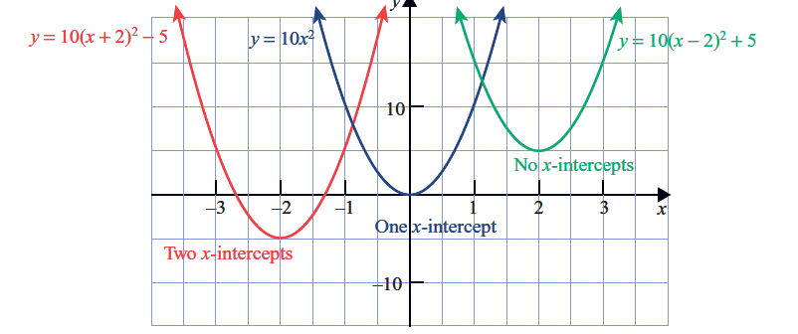



Concept Development
The graph of a quadratic equation is a parabola, as shown below.
Every parabola has:
An axis of symmetry
A turning point
X-intercept (where it cuts x-axis):
- can have 2, 1 or 0 x-intercepts
$$x=−2$$
$$x=0$$
$$x=2$$
Minimum TP at (-2, -5)
Minimum TP at (0, 0)
Minimum TP at (2, 5)
1 x-intercept at 0
No x-intercepts
2 x-intercepts at -2 and 4

Slide 13




Skill Development/Guided Practice
Will this be a n shape or u shape parabola?
Sketch the graph of the following equation $y =−x2+x+2.$
We want to graph the equation $y =−x2+x+3$using integer
values of x from -3 to 2. Substitute each number into the equation to find the
points we need. (Use a scientific calculator and brackets to help you do this.)
$$y =−x2+x+2$$
$$y =−1\left(−3\right)2+\left(−3\right)+2$$
$=−1(9)−3+2$
$=−10$
$$y =−x2+x+2$$
$$y =−1\left(−1\right)2+\left(−1\right)+2$$
$=−1(1)−1+2$
$=0$
$$y =−x2+x+2$$
$$y =−1\left(2\right)2+\left(2\right)+2$$
$=−1(4)+2+2$
$=0$
x | -3 | -2 | -1 | 0 | 1 | 2
y | -10 | -4 | 0 | 2 | 2 | 0

Slide 14
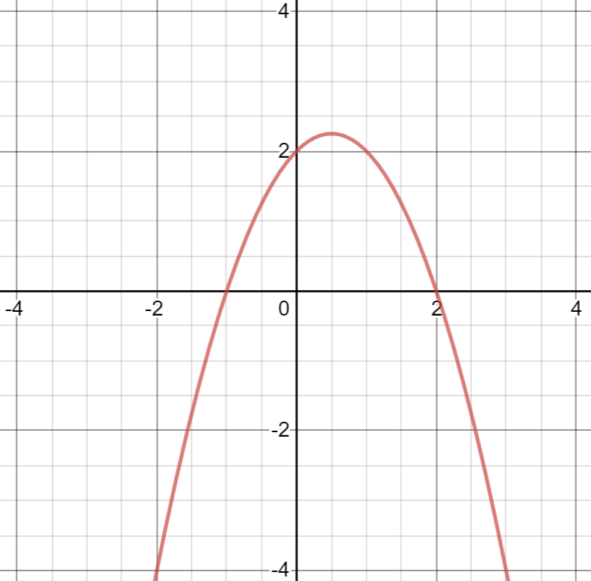
Skill Development/Guided Practice
Sketch the graph of the following equation $y =−x2+x+2.$
This quadratic relationship has a:
Axis of symmetry at x = 0.5
Maximum TP at (0.5, 2.25)
2 x-intercepts at -1 and 2

Slide 15




Skill Development/Guided Practice
Will this be a n shape or u shape parabola?
Sketch the graph of the following equation $y =x2−5x+6.$
We want to graph the equation $y =x2−5x+6$using integer
values of x from -3 to 2. Substitute each number into the equation to find the
points we need. (Use a scientific calculator and brackets to help you do this.)
$$y =x2−5x+6$$
$$y =\left(−3\right)2−5\left(−3\right)+6$$
$=\left(9\right)+15+6$
$=30$
$$y =x2−5x+6$$
$$y =\left(−1\right)2−5\left(−1\right)+6$$
$=\left(1\right)+5+6$
$=12$
$$y =x2−5x+6$$
$$y =\left(2\right)2−5\left(2\right)+6$$
$=\left(4\right)−10+6$
$=0$
x | -3 | -2 | -1 | 0 | 1 | 2
y | 30 | 20 | 12 | 6 | 2 | 0

Slide 16
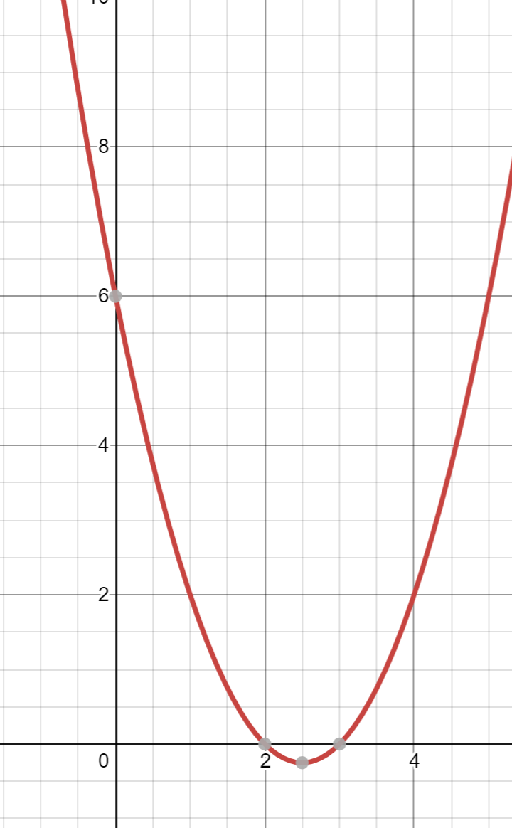
Skill Development/Guided Practice
Sketch the graph of the following equation $y =x2−5x+6.$
This quadratic relationship has a:
Axis of symmetry at x = 2.5
Minimum TP at (2.5, -0.25)
2 x-intercepts at 2 and 3

Slide 17
Independent Practice
The graph of a quadratic equation is a parabola, as shown below.
Every parabola has:
An axis of symmetry
A turning point
X-intercept (where it cuts x-axis):
- can have 2, 1 or 0 x-intercepts
$$x=−2$$
$$x=0$$
$$x=2$$
Minimum TP at (-2, -5)
Minimum TP at (0, 0)
Minimum TP at (2, 5)
1 x-intercept at 0
No x-intercepts
2 x-intercepts at -2 and 4

